Slide 1
How is Climate Change Linked to Air Pollution?
Notes:
As a result of participating in this lesson you will be able to:
RECALL what climate change and air pollution are.
UNDERSTAND how to use data to come to an informed decision.
CREATE a news article detailing the link between climate change and air pollution.

Slide 2
Can you list three…
Ways that air pollution contributes to the greenhouse effect?
Tip!
Think back to two lessons ago.
Notes:
Starter Task: 10 mins
Ask students to think about how air pollution contributes to the greenhouse effect. Ask them to list three ways in which air pollution contributes to this.
Take feedback and draw out key points about ways in which air pollution not only causes health problems but also contributes to climate change.
See next slide for possible answers.

Slide 3
Ways in which air pollution contributes to the greenhouse effect
Transport
Generating energy
Food production
Deforestation
Plastic and waste
Powering industry
Notes:
Answers could include:
Transport: cars, buses, lorries, ships and planes (unless electric and charged with renewable energy)
Generating energy: a lot of power generation for electricity and the vast majority of home heating is still done by burning fossil fuels, such as gas.
Food production: livestock reared for meat and diary products emit methane, and agricultural soils emit gases likes nitrous oxide, which is made from nitrogen in the soil through the use of fertilisers.
Deforestation: because trees store carbon as they grow, cutting down or burning down trees releases carbon into the atmosphere.
Plastic and waste: plastics are made from fossil fuels, releasing emissions through their production.
Powering industry: industrial emissions come from producing things like cement, iron, steel, electronics, plastics and clothing. All countries are now largely dependent on fossil fuels to build and sustain their economies.

Slide 4


Think, Pair, Share.
Live Air Quality Data from Wigan Borough
Visit the Wigan Air Quality hub and use the interactive map to answer the questions on your worksheet:
Identify patterns in the data
Suggest the sources of this pollution
Explain why certain areas have worse data than others.
Notes:
Main Task 1: 20 mins
NOTE: Please note that the following resources are pilot resources, and some elements of them, such as the Air Quality Interactive Map, are still under development. Although they may not be fully available at the moment, they are being actively worked on and will be released for further piloting soon.
Using the live data for the air quality sensors and maps showing the locations of the sensors, ask students to THINK, PAIR and SHARE ideas to:
Identify patterns in the data (revisiting ideas from Lesson 3)
Suggest the sources of this pollution (drawing on ideas from the Starter Task)
Explain why certain areas have worse data than others.

Slide 5
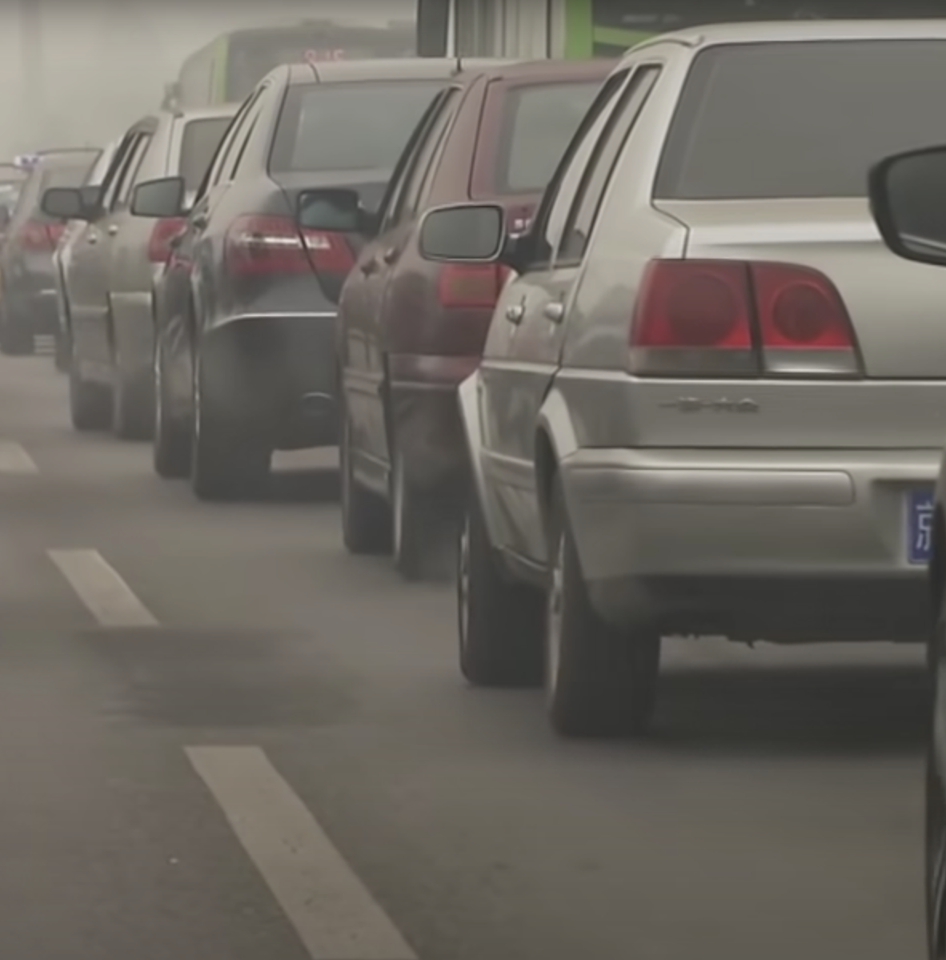

Air Pollution 101
If you need to pause the video or watch any parts over again, just pop your hand up!
Notes:
Main Task 2: 20 mins
Explain to students that they are now going to explore in more detail the link between air quality and climate change.
Distribute Student Activity Sheets.
Show students the video “Air Pollution 101” and explain that they will need to complete entries on the table on the Student Activity Sheet.
Video url: https://www.youtube.com/watch?v=e6rglsLy1Ys

Slide 6
Air Pollution 101
Type of human-made air pollution | State one cause of this type of pollution | State one effect of this type of pollution
1.
2.
3.
Notes:
Display table on Whiteboard.

Slide 7

Tweeting ‘Air Pollution’
Write a two-sentence tweet which highlights one of the effects of air pollution with a change which would help to address this.
Notes:
Plenary: 10 mins
Ask students to create a two-sentence tweet highlighting one of the effects of air pollution with a change which would help to address this.
Encourage students to think about both changes in personal behaviour as well as what governments and large organisations should do.

