Slide 1
What is Climate Change?
Notes:
As a result of participating in this lesson you will be able to:
REMEMBER what climate change is.
UNDERSTAND what causes climate change.
EXPLAIN the effects of climate change on our planet.

Slide 2
True, False or Partly True?
Renewable energy is too
expensive for most people to afford.
The Earth’s climate has always changed – climate change is nothing new.
Carbon dioxide levels are at their highest level for 800,000 years.
Climate change has been caused by emissions from China.
Animals and plants will adapt to climate change.
Global warming will mean it will be like summer all the time.
Notes:
Introduction / Do Now Task: 10 mins
Ask students to consider each of the statements shown and decide whether they are TRUE, PARTLY TRUE or FALSE.
See next slide for suggested responses.

Slide 3
The Answers: Part 1
Renewable energy is too expensive for most people to afford. FALSE: mains electricity generated in the UK costs less from wind or solar.
The Earth’s climate has always changed – climate change is nothing new. PARTLY TRUE: the climate has changed in the past but at a much slower rate than it is doing now.
Carbon dioxide levels are at their highest level for 800,000 years. TRUE.

Slide 4
The Answers: Part 2
4. Climate change has been caused by emissions from China. FALSE: whereas China is a major source of greenhouse gas emissions, many other countries are also sources. China is a major investor in green technology.
5. Animals and plants will adapt to climate change. PARTLY TRUE: but such adaptations will take many organisms a much longer period of time.
6. Global warming will mean it will be like summer all the time. FALSE: one of the effects of global warming is the increased incidence of severe storms.

Slide 5
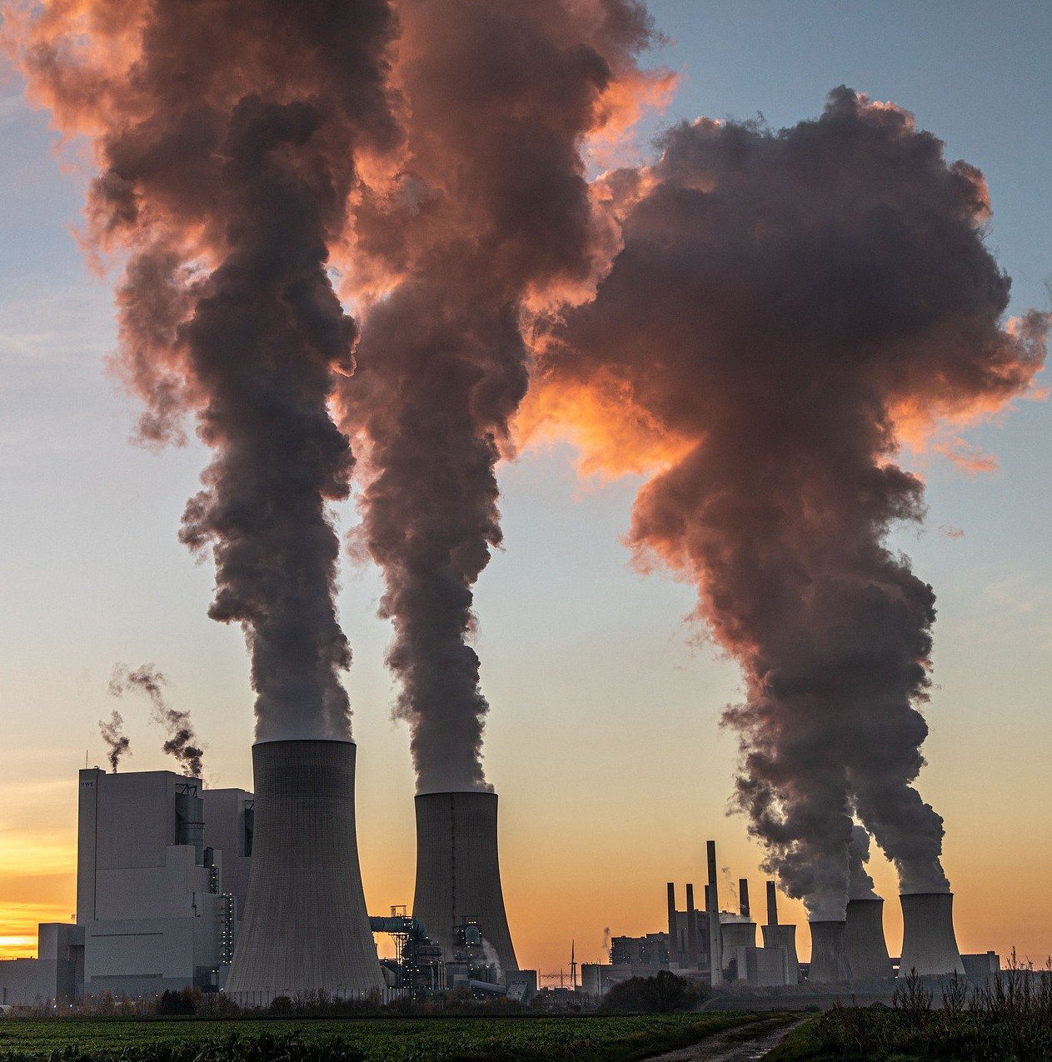
What Causes Climate Change?
Whilst watching this video, try and…
Name the gases that are responsible for the greenhouse effect.
Name the four things that the video suggests are affected by climate change.
Write a sentence for each of those four things, giving an example of how they may change.
Notes:
Starter Task: 15 mins
Ask students to watch the film, advise them the answers to the 3 questions are within the film.
You might want to pause the film at points or show it more than once.

Slide 6
Air pollution consists of chemicals or particles in the air that can harm the health of humans, animals, and plants.
It also damages buildings.
National Geographic

Slide 7
Explaining Climate Change
Get into groups
of 2 or 3.
You will have 10 minutes to deliver a response to the following task.
After 10 minutes, you will present your answer to another group, and listen to theirs.
Notes:
Main Task - Explaining Climate Change: 25 mins
Explain the next task to students.

Slide 8
Group task
“Imagine that you have a younger brother or sister who is in KS2; they come home from school one day and ask you what climate change is.
You decide to explain it in a way that will be able to understand.
Your explanation should also discuss how humans are contributing to climate change and how we can reduce global warming.”
Use the Success Criteria Worksheet to structure your answers and give feedback on others.
Notes:
Put students into groups of 2 or 3 and advise them they will have 10 mins to work in a group to create a presentation that they will present to the other groups.
Distribute Student Task Sheets - advise they should follow the success criteria on the worksheets as a guide to what they need to prepare.

Slide 9
Success Criteria
Does the presentation:
Explain clearly what the greenhouse effect is?
Identify at least two greenhouse gases?
Describe ways in which humans are impacting on the climate?
Identify at least two ways that humans can reduce the greenhouse effect and stop global warming?
Notes:
Success Criteria
Does the presentation:
Explain clearly what the greenhouse effect is?
Identify at least two greenhouse gases?
Describe ways in which humans are impacting on the climate?
Identify at least two ways that humans can reduce the greenhouse effect and stop global warming?
In addition:
Is it suitable for the target age range?
Is it engaging?
Is it clear and well structured?

Slide 10
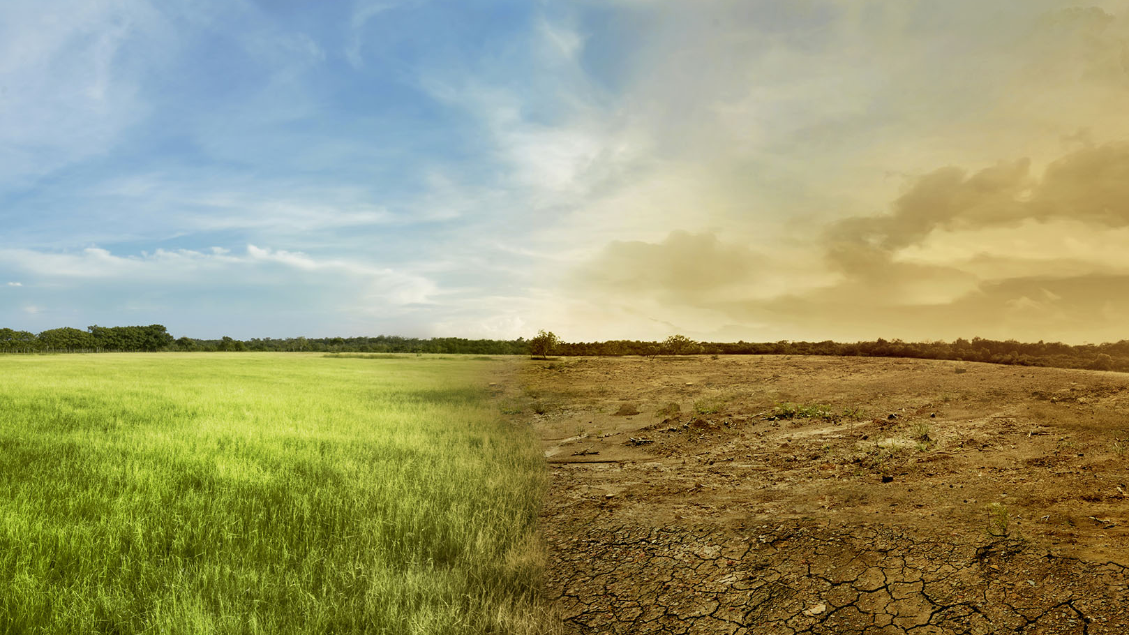
Effects of climate change
Notes:
Plenary: 10 mins
Show images of natural disasters or extreme weather, such as melting ice caps, drought, forest fires or flooding as examples of the effects of climate change.
Prompt students to discuss the image shown with the person next to them and why they think these are the effects of climate change.

