Slide 1
Gathering and Measuring Particulates?
Notes:
As a result of participating in this lesson you will be able to:
REMEMBER what climate change is.
UNDERSTAND what causes climate change.
EXPLAIN the effects of climate change on our planet.

Slide 2
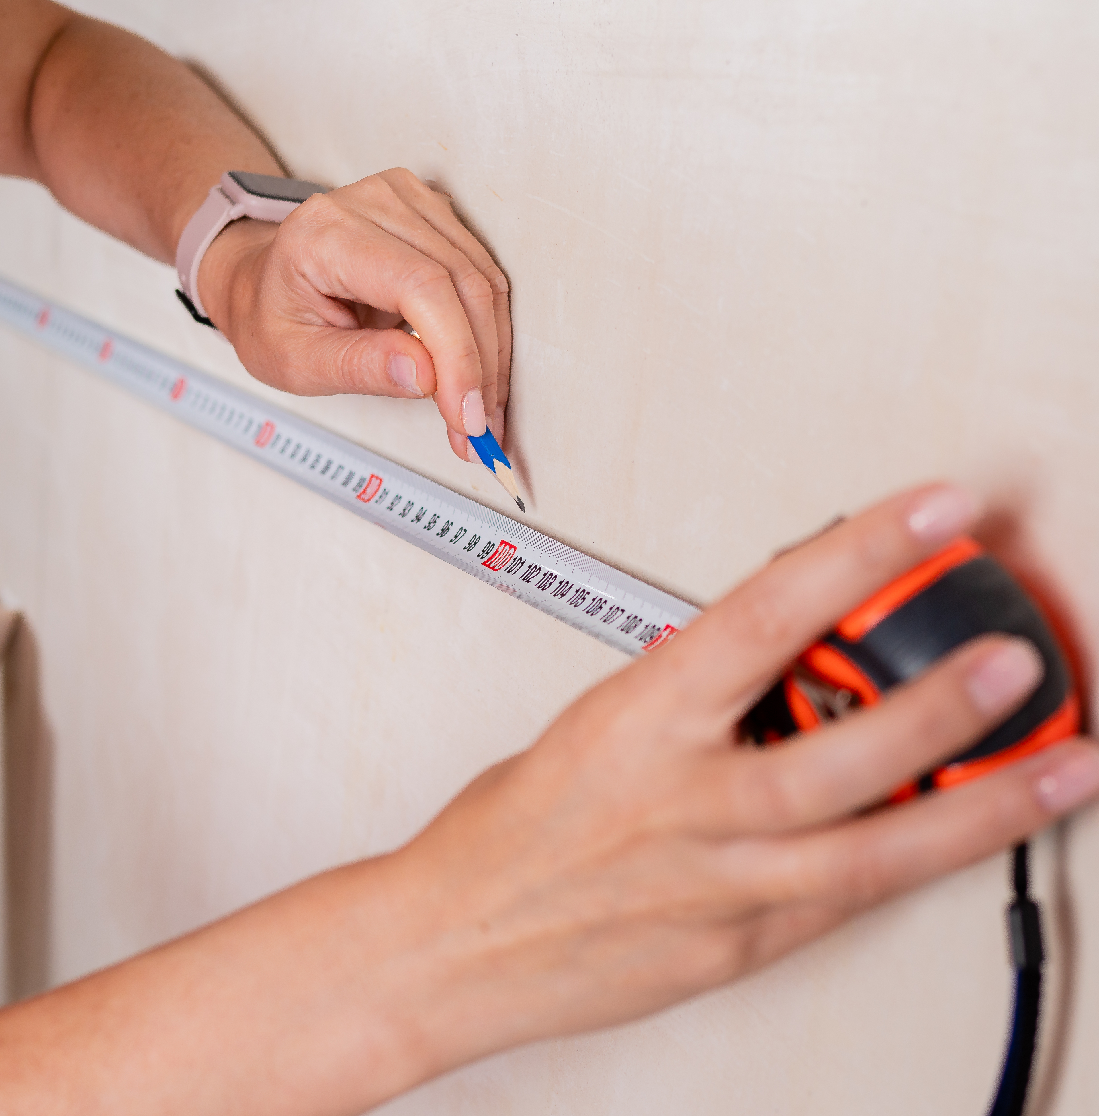
Sort the below units in terms of decreasing size:
Microns
Centimeters
Nanometers
Meters
Millimeters
Notes:
Introduction/Do Now Task: 5 mins
Ask students to work in pairs and sort out these units in terms of decreasing size (i.e. largest first)
• Microns, or micrometres
• Centimetres
• Nanometres
• Metres
• Millimetres

Slide 3
Correct answer
Metres
Centimetres
Millimetres
Microns (micrometres)
Nanometres
Notes:
Share correct the anwers with students
Metres
Centimetres
Millimetres
Microns (micrometres)
Nanometres

Slide 4
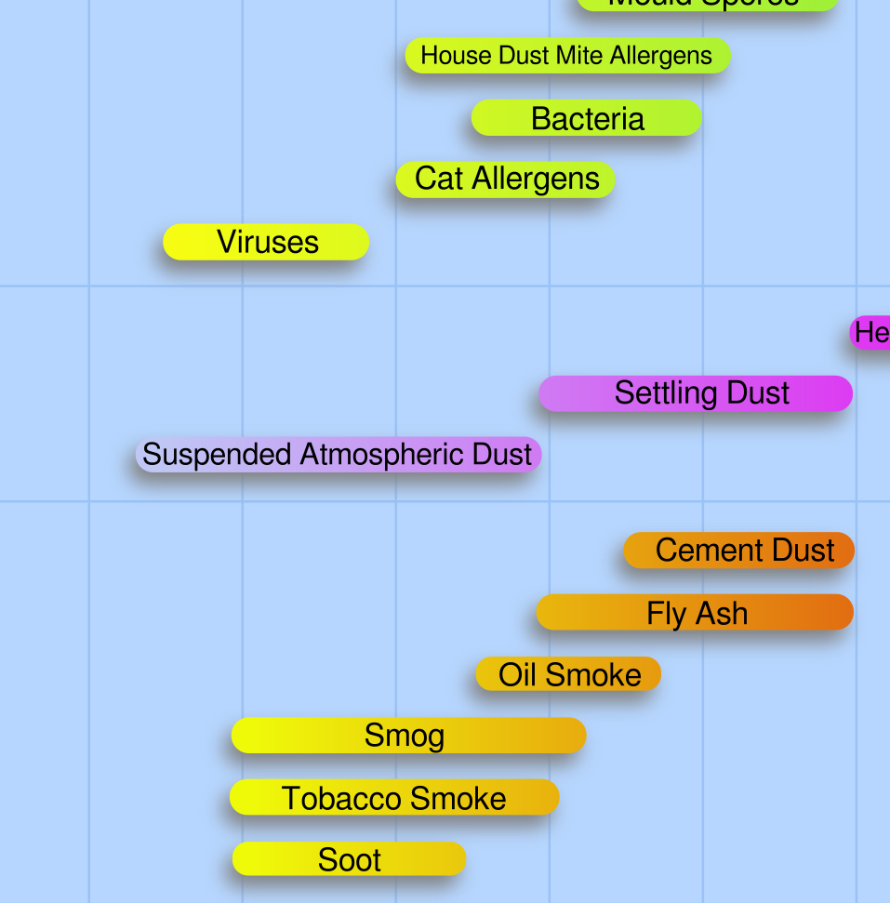
What does this chart tell you?
Notes:
Starter Task: 15 mins
Introduce the poster and say that it relates to air pollution.
Ask students to work in small groups, either with a printed copy of the poster or with sight of one on a screen, and to study it to explain what it shows.
Allow students a few minutes to examine the poster, deal with any questions with individual groups and then take feedback, with each group contributing, as far as possible, a different point.
Draw out key points such as:
• Not all atmospheric pollutants are gases
• Pollutants come from a variety of sources
• Some pollutants are referred to as particulates
• Different particulates have different sizes
Explain that in this lesson they are going to be studying particulates

Slide 5
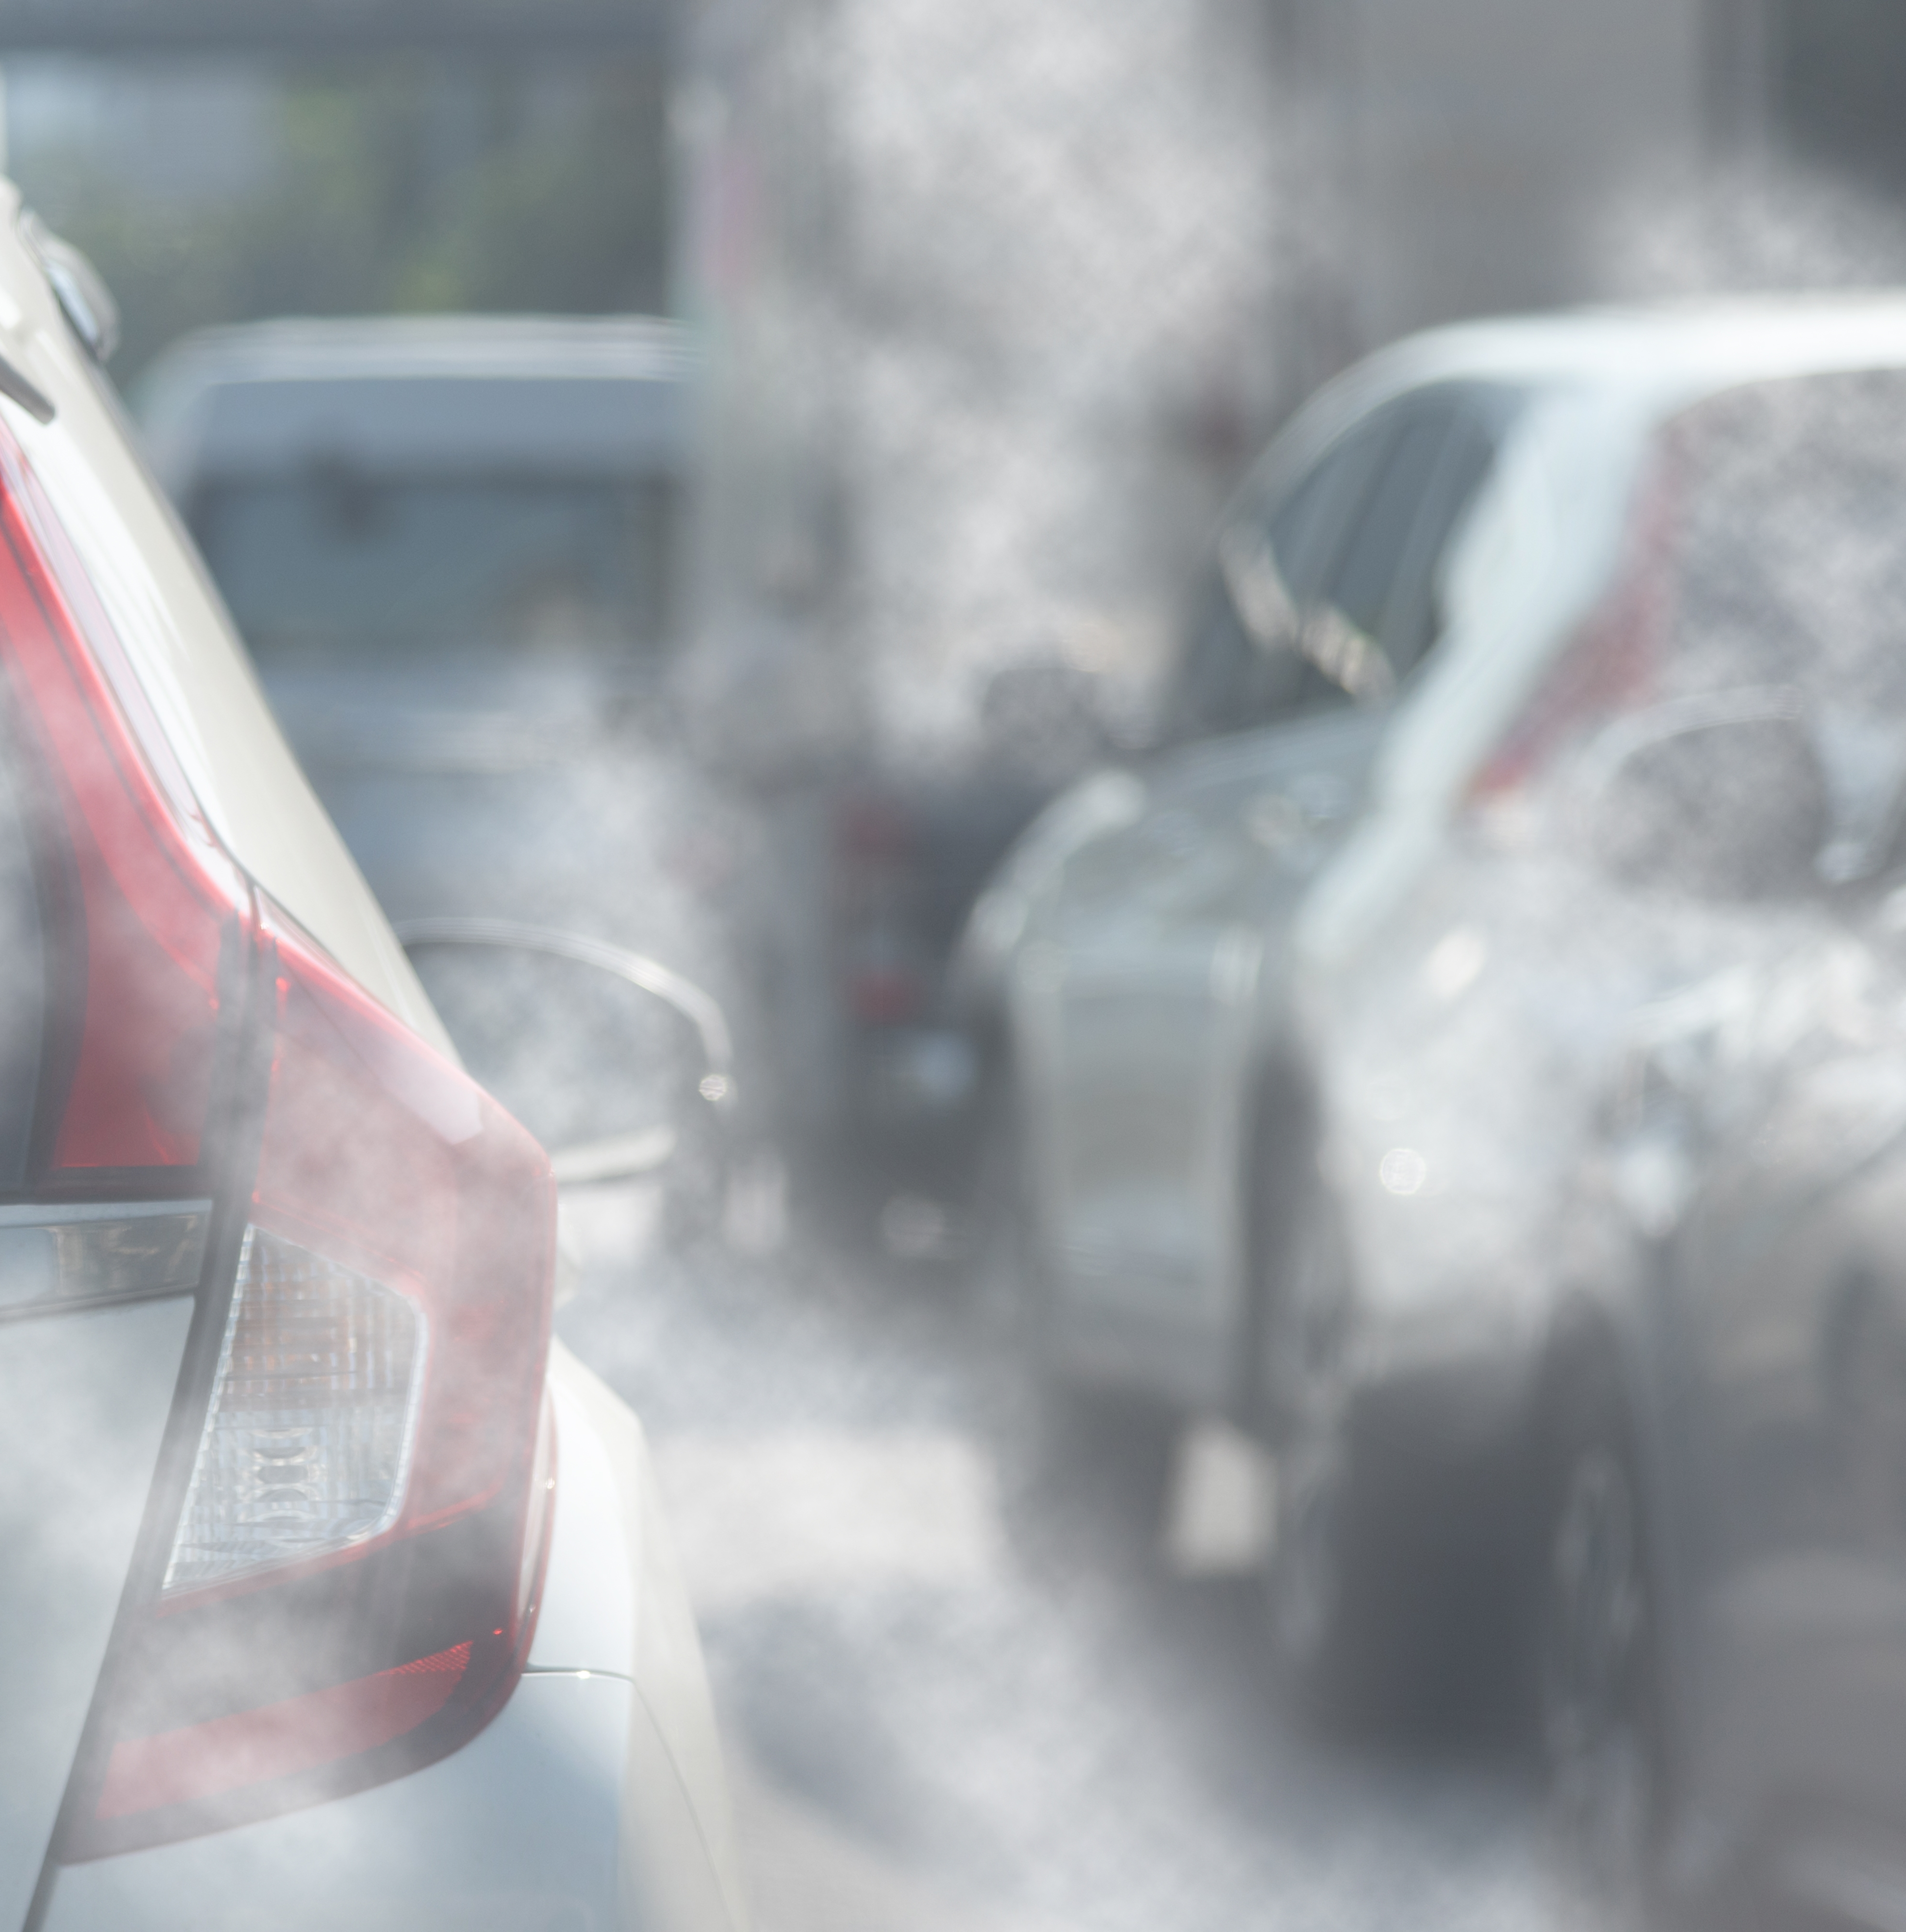
Gathering Particulates
Notes:
Main Task 1:

Slide 6
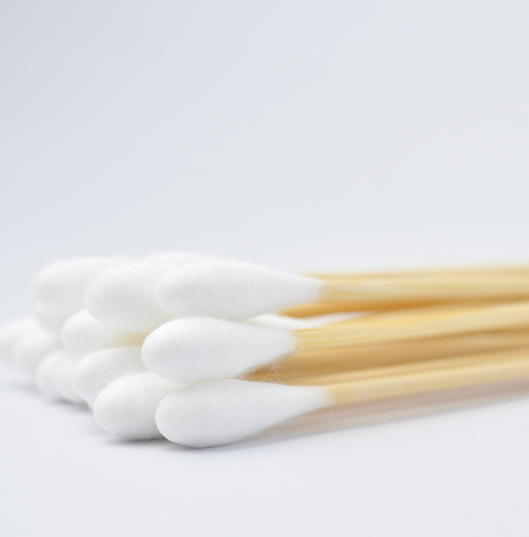
Gathering Particulates
With cotton wool swabs.
By looking at the swabs…
What conclusions can be drawn
What are the advantages and limitations of this measurement technique?
What further evidence can be gathered?
Notes:
Main Task 1: Gathering Particulates – Procedure 1 (25 mins)
This activity can either by done in advance, or students can be involved in gathering the evidence. In either case it is a good idea to test the area to be used in advance, to make sure it will yield evidence that can be analysed.
Cotton wool swabs need to be used to wipe surfaces on which particulates are likely to have settled. Suitable surfaces include lampposts and railings near to roads. Swabs should be used in a consistent way (i.e. similar pressure and over a similar distance on the surface).
It is a good idea to have swabs from several surfaces that vary in position.
For example:
• At a number of points different distances away from a busy road.
• At a number of different heights above the ground.
In each case this factor should be measured and recorded.
The swabs can then be compared. A good way of doing this is to fix the swabs to a chart that displays the other variable and display this so that students can study it.
Ask students to look at the swabs and:
• Suggest conclusions that can be drawn
• Suggest the advantages and limitations of this technique
• Suggest further evidence that could be gathered

Slide 7
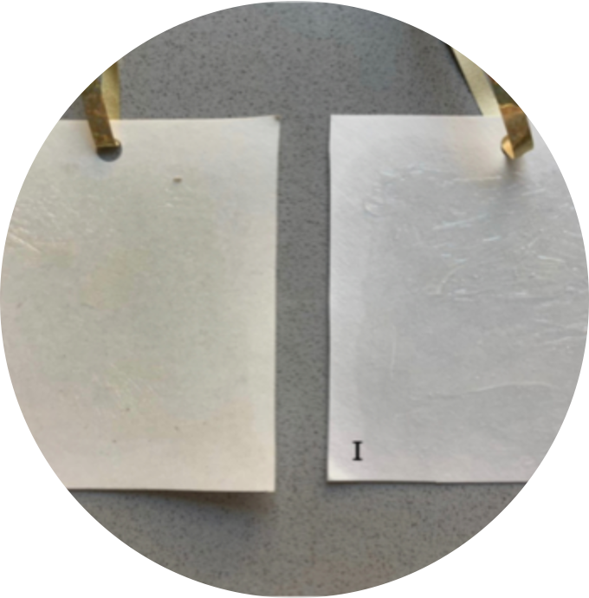
Gathering Particulates
With adhesive pads.
Do you think this technique would produce useful data?
Compare this technique with the cotton swabs method.
Why might researchers want to use both techniques?
Notes:
Main Task 2: Gathering Particulates – Procedure 2 (10 mins)
Explain that another way of gathering particulates is to use adhesive pads which can be hung up in various areas and left for several days.
Particulates in the air become attached to the pads. The pads are then removed and examined using a microscope to explore the level of particulate pollution in that location.
Ask students to:
• Consider whether this technique would produce useful data
• Compare this technique with the swab tests
• Suggest why researchers might want to use both procedures.

Slide 8
What three things have you learnt this lesson?
Notes:
Plenary: 5 mins
Ask students to suggest three things they’ve learned in this lesson about particulates and air pollution.
Take a sample of responses.

